Slide 1
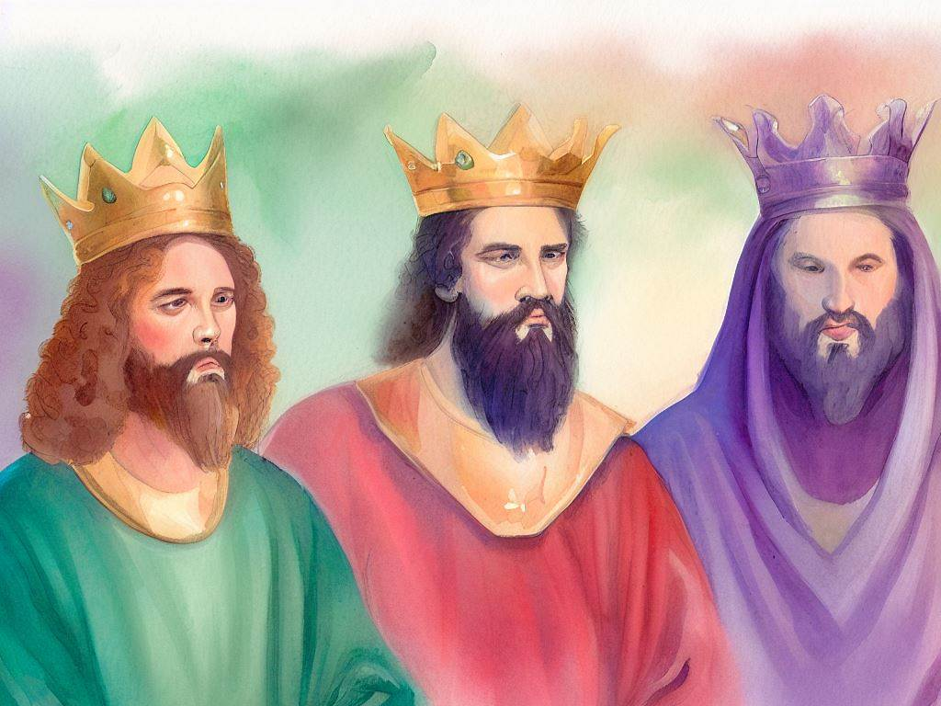
United Kingdom
Quarter 4: Lesson 22
The Penitential Psalms
(Psalm 6, 38, 51, 32)

Slide 2
Sin
What is sin?
A transgression of the law of God (1 John 3:4)
Rebellion against God (Deut. 9:7; Joshua 1:18)
What is the effect of sin?
Death (Romans 6:23)
Physical in some instances
Separation from God in all instances (Isaiah 59:2)
How does sin affect us as individuals?
The weight of the consequences of our sins
The beauty to behold when God forgives

Slide 3
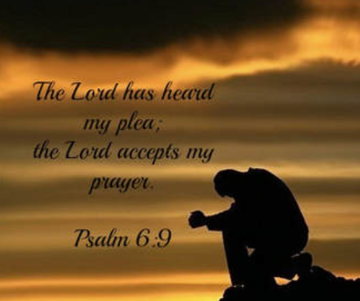
Psalm 6
Verses 1-3
A cry for mercy
Verses 4-5
A plea for deliverance
Verses 6-7
Anguish and weariness
Verses 8-10
Confidence in God’s justice

Slide 4
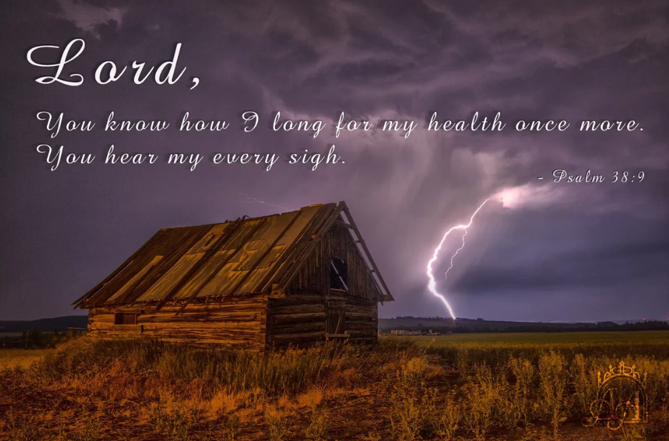
Psalm 38
Verses 1-8
A lamentation of sin and suffering
Verses 9-14
An admission of weakness and isolation
Verses 15-22
A plea for deliverance

Slide 5
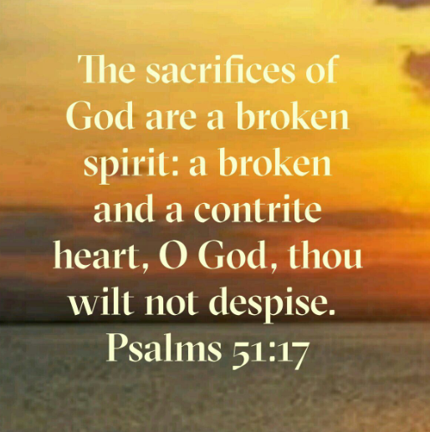
Psalm 51
Verses 1-2
Acknowledging sin
Verses 3-6
Confession and repentance
Verses 7-12
Petition for cleansing and restoration
Verses 13-17
Commitment to change
Verses 18-19
Prayer for Zion and Jerusalem

Slide 6
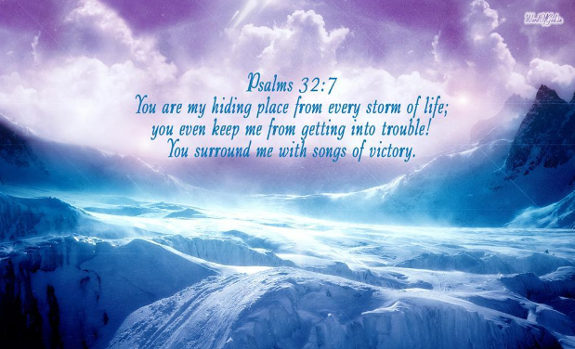
Psalm 32
Verses 1-2
The joy of forgiveness
Verses 3-4
The agony of concealed sin
Verses 5
The liberation through confession
Verses 6-7
The prayers of the righteous

Slide 7
Psalm 32
Verses 8-9
The divine instruction
Verses 10-11
The contrast of the wicked and the righteous

Slide 8
Lessons
Sin has a tremendously negative impact upon a person. We should desire not to have these negative feelings by serving God with gladness
Let’s be thankful that we serve a loving God who is longsuffering… “not willing that any should perish but that all should come to repentance” (2 Peter 3:9b)

